Slide 1
Communications network architecture
Instructor: Gordon Ariho

Slide 2
Introduction
A network can range from simply two computers that are linked together to the complexity of computers that can access data across continents.
Networks are used to improve communication between departments, foster customer relationships, and share data
As a network administrator, it is your job to manage the network.
To do this, you must understand the fundamental networking principles.
Having this knowledge will help develop your planning and troubleshooting skills.

Slide 3
NETWORK CONSIDERATIONS
When you decide to connect computers to form a network, you have to ask yourself many questions.
What type of network will you use?
What operating systems do you have?
Which operating systems do you want to add?
How much money do you want to spend?
What type of hardware and software is best for what you want to do?
etc.
Notes:
You may want to set up a quick and inexpensive network to enable file sharing
between your desktop and laptop computers. You may want to build a more
complex network that includes a server, six workstations, multiple printers, and
other shared resources.

Slide 4
UNDERSTANDING NETWORK BASICS
All networks use some basic hardware and software, but different configurations of this equipment define the type and uses of the network.
Understanding network uses and network types helps you plan your network. e.g. networking a home is different from networking an office building
Understanding the pros and cons of networking helps you plan the exact network that’s right for you, your family or a business
Before you can plan your network, buy the hardware and software, you need to understand some basic networking terms and technologies.
Notes:
For
example, you may want to network two computers in the same room. The
equipment you use to achieve this network can be different from the hardware
you use to network two computers in different rooms or even in different
buildings. Similarly, the hardware you use to enable two computers to use one
Internet connection is different than the software you use for two computers
sharing a printer.

Slide 5
UNDERSTANDING NETWORK BASICS
There are many names for networks, often related to their size. Local area network (LAN) is perhaps the most common name for a network. A LAN contains two or more computers and is generally housed in one building.
Home networks, however, are starting to be called by other names. TAN (Tiny area network). Then there’s HAN(home area network).
Communication and resources sharing
Members of a network have access to shared resources
Can share files without having to move
Share expensive resources
Notes:
Remember, a network is a system that connects two or more
computers so that they can communicate and share resources with each other.

Slide 6
Advantages of networking
Sharing Files .e.g. intranet, skype, Instagram, Dropbox, BitTorrent etc.
Sharing Disk Space e.g. file storage on the intranet
Creating Backups
Sharing Peripherals .e.g. printers, scanners, etc.
Working with Applications (Centralized Software Management)
Accessing the Internet .i.e. peer-to-peer
Expanding your Network
Security
Notes:
Many Windows, Macintosh, and Linux computers include the networking
software you need; you can purchase the networking hardware and install it all
yourself. Alternatively, kits are available that include all the hardware you
need to put together a home network. You can choose the features that are
important to you, whether you desire speed, shared Internet access, security, or
all these features.

Slide 7
Disadvantages of networking
Expensive to Install
Administrative Time Requirements
File Server Failures
Broken Cables
Security Threats
Bandwidth Issues
Notes:
While there are many advantages to installing a home or office network, there
can be disadvantages too. If you're seriously thinking about setting up your
own network, you should be informed about all of the advantages and
disadvantages too.

Slide 8
Network Line Configuration
Network Line configuration refers to the way two or more communication devices are attached to a link.
A link is a communication medium through which data is communicated between devices.
For communication to occur between two devices, they must be connected to the same link at the same time. The two possible types of line configurations or connections are discussed in the this sections.
Notes:
. Line configuration is also referred to as connection.

Slide 9
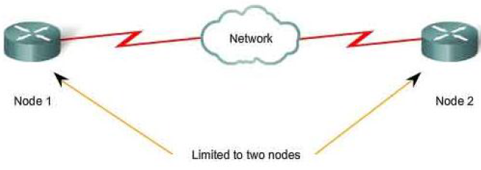
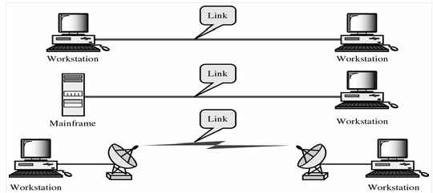
Point to point

Slide 10
Point to point
A Point to Point Line Configuration Provide dedicated link between two devices and use actual length of wire or cable to connect the two ends including microwave & satellite link. Infrared remote control & TVs remote control.
The entire capacity of the channel is reserved for transmission between those two devices. Most point-to-point line configurations use an actual length of wire or cable to connect the two ends, but other options, such as microwave or satellite links, are also possible.
Notes:
Point to point network topology is considered to be one of the easiest and most conventional network topologies.
It is also the simplest to establish and understand.
To visualize, one can consider point to point network topology as two phones connected end to end for a two way communication

Slide 11
Point-to-Point Connection
In this type of network, when a message is sent from one computer to another, it usually has to be sent via other computers in the network.
A point-to-point network consists of many connections between individual pairs of computers.
This type of network is sometimes called a store and forward network or a packet switched network.
Notes:
As a general rule, large networks such as Wide Area Networks are organized in this fashion.

Slide 12
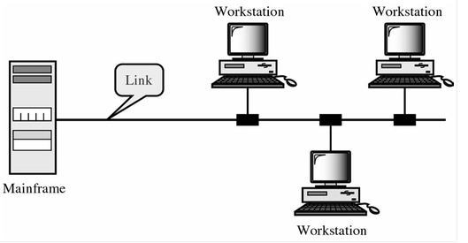
Multipoint Connection
Multipoint Configuration also known as Multidrop line configuration
One or more than two specific devices share a single link
e.g. consider 15 pluggable DC 125 docking clients connected to a single windows multipoint server
Notes:
Capacity of the channel is shared.
A typical example of a multipoint connection is the internet where more
than one device can access a dedicated server.

Slide 13
Multipoint Connection
More than two devices share the Link that is the capacity of the channel is shared now. With shared capacity, there can be two possibilities in a Multipoint Line Configuration:
Spatial Sharing: If several devices can share the link simultaneously, its called Spatially shared line configuration
Temporal (Time) Sharing: If users must take turns using the link , then its called Temporally shared or Time Shared Line Configuration
Notes:
http://mucins.weebly.com/21-line-configuration.html

Slide 14
Network Topologies
In simple terms, a computer network consists of two or more connected computers.
When computers are connected, we must choose network infrastructure, which is the combination of all the physical and logical components.
Network topology defines the structure of the network. It falls into two categories: Physical and Logical topology.
Physical topology is the actual layout of the wire or media.

Slide 15
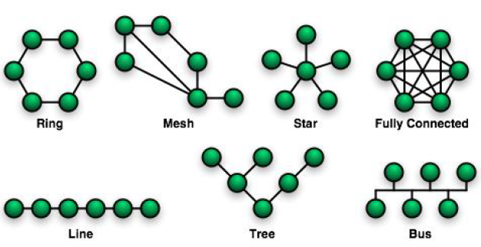
PHYSICAL TOPOLOGIES USED IN LANs

Slide 16
PHYSICAL TOPOLOGIES USED IN LANs
Ring topology
Connects one host to the next and the last host to the first. This creates a physical ring of cable.
A mesh topology
It’s implemented to provide as much protection as possible from interruption of service.
Each host has its own connections to all other hosts. Although the Internet has multiple paths to any one location, it does not adopt the full mesh topology
Star topology
Connects all cables to a central point of concentration.

Slide 17
PHYSICAL TOPOLOGIES USED IN LADs
Line topology
Connects one host to the next and the last host doesn’t connect to the first. This creates a physical line of cable.
Tree (hierarchical) topology
Similar to an extended star. However, instead of linking the hubs and/or switches together, the system is linked to a computer that controls the traffic on the topology.
Bus topology
uses a single backbone cable that is terminated at both ends.
All the hosts connect directly to this backbone.
Notes:
A backbone is the part of a network that handles the major traffic, consisting of many
different networks and running long distances. It is made up of a large
collection of interconnected commercial, government, academic and other
high-capacity data routes and core routers that carry data across the
countries, continents and oceans of the world.

Slide 18
LOGICAL TOPOLOGIES
The logical topology of a network is how the hosts communicate across the medium. The two most common types of logical topologies are broadcast and token passing.
Broadcast topology
means that each host sends its data to all other hosts on the network medium. There is no order that the stations must follow to use the network. It is first come, first serve. Ethernet works this way as will be explained later .

Slide 19
LOGICAL TOPOLOGIES
Token passing
Controls network access by passing an electronic token sequentially to each host.
When a host receives the token, that host can send data on the network.
If the host has no data to send, it passes the token to the next host and the process repeats itself. Two examples of networks that use token passing are Token Ring and Fiber Distributed Data Interface (FDDI).

Slide 20
NETWORKING AND INTERNETWORKING DEVICES
Internetworking is the practice of connecting a computer network with other networks through the use of gateways that provide a common method of routing information packets between the networks.
The resulting system of interconnected networks is called an internetwork, or simply an internet
networking is the practice of linking two or more computing devices together for the purpose of sharing data.
Notes:
Networks are built with a mix of computer hardware and computer software.

Slide 21
ROUTER
A router is an intelligent connecting device that can send packets to the correct LAN segment to take them to their destination. Routers form the backbone of the internet. A router directs data packets from one network to another
Routers link LAN segments at the network layer of the OSI Reference Model for computer- to-computer communications.
The networks connected by routers can use similar or different networking protocols.

Slide 22
ROUTER
A router may be one or more of the following types:
Central
Acts as a network backbone, connecting many LANs.
Peripheral
Connects individual LANs to either a central router or to another peripheral router.
Local
Operates within its LAN driver’s cable-length limitations.
Remote
Connects beyond its device\ driver limitations, perhaps through a modem\ or remote connection.
Internal
Part of a network file server.
External
Located in a workstation on the network.
Notes:
Ring and mesh topologies are felt convenient for peer to peer transmission.
Star and tree are more convenient for client server.
Bus topology is equally convenient for either of them.

Slide 23
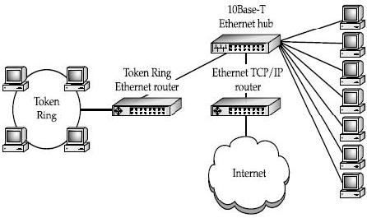
NETWORKING USING A ROUTER

Slide 24
hub
A hub, sometimes called a concentrator, is a device that connects a number of network cables coming from client computers to a network. Hubs come in many different sizes, supporting from as few as two computers up to large hubs that may support 60 computers or more.
All the network connections on a hub share a single collision domain, which is a fancy way of saying all the connections to a hub “talk” over a single logical wire and are subject to interference from other computers connected to the same hub.
Notes:
(The most common hub size supports 24 network connections.)

Slide 25
A SWITCH
A switch is wired very similar to a hub, and actually looks just like a hub.
However, on a switch all of the network connections are on their own collision domain.
The switch makes each network connection a private one, and then collects the data from each of the connections and forwards the data to a network backbone, which usually runs at a much higher speed than the individual switch connections.
Often, switches are used to connect many hubs to a single network backbone. Switches are a lot like bridges, except that they have many ports and otherwise look like a hub. You might think of a switch as a sort of multiport bridge.

Slide 26
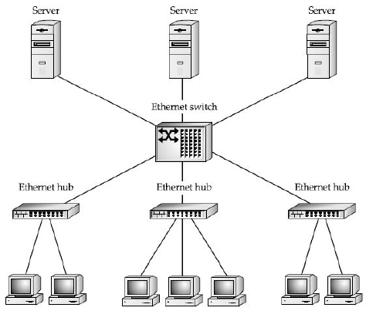
USING HUBs AND SWITCHs

Slide 27
REPEATER
A repeater is a device that extends the distance of a particular network run.
It takes a weak network signal in on one side, boosts the signal, then sends it out its other side.
Repeaters operate at the physical layer of the OSI networking model.
They do not have the intelligence to understand the signals that they are transmitting. Repeaters merely amplify the signal coming in either side and repeat it out their other side.
Notes:
Extends distances by repeating a signal
Any slight variations in the carrier wave for individual bits is corrected when the carrier wave is reproduced

Slide 28
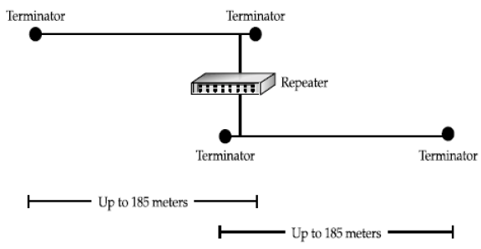
Using repeater to increase network length

Slide 29
More points to note about a repeater
Repeaters are only used to connect the same type of media, such as 10Base-2 to 10Base-2, or Token Ring to Token Ring.
Repeaters do have a small amount of intelligence that can be useful. They can segment one of their connections from the other when there is a problem.
For example, consider two segments of Thin Ethernet that are connected using a repeater. If one of those segments is broken, the repeater still allows the good segment to continue working within itself. Users on the good segment will be unable to connect to resources on the broken segment, but they can continue to use the good segment without trouble. (Remember, though, this capability does you little good if your servers are on the broken segment and your workstations are on the good segment!)

Slide 30
BRIDGE
Bridges are basically more intelligent versions of repeaters.
Bridges can connect two network segments together, but they have the intelligence to pass traffic from one segment to another only when that traffic is destined for the other segment.
Bridges are, therefore, used to segment networks into smaller pieces. Some bridges are also available that can span different networking systems and media, such as from coaxial Thin Ethernet to twisted-pair Token Ring.

Slide 31
Bridges cont’d
Bridges operate one layer higher, at the data-link layer (Layer 2).
Bridges examine the Media Access Control (MAC) address of each packet they encounter to determine whether they should forward the packet to the other network.
Bridges contain address information about all the parts of your network, through either a static routing table that you program or a dynamic, learning-tree system that discovers all the devices and addresses on the network.

Slide 32
Connection-oriented and connectionless services
The two primary types of services which are made available by a particular network layer and which actually are also useful classifications for many nontechnical types of service industries are known as connection-oriented and connectionless communication.

Slide 33
Connection-oriented Services
One of the easiest ways to understand what a connection-oriented protocol is would be to think of a very familiar service upon which it's based: the telephone system.
When you pick up the phone, you have an open circuit, and the dial tone carrier signal allows you to connect to a destination of your choice.
Given valid input parameters, the service:
Establishes the connection.
Allows you to utilize the connection.
Tears down the connection when you done using it.
In a connection-oriented system, all of your communications are taking place on the same transmission channel.
Notes:
The primary difference between this method and that of a connectionless
service is that in a connection-oriented system, all of your communications are
taking place on the same transmission channel. On the other hand, with a
connectionless service, all transmissions are independently routed, and perhaps
re-assembled in some order at the other end -- the service in between has no
inherent responsibility for ensuring ordinality -- it need only assure that each
transmission gets delivered from its source to its destination.

Slide 34
Connectionless Services
A good analogy for a connectionless service is the process of sending letters through the postal system.
Each transmission (the "letter") contains the full destination address and is processed independent of related messages. As described above, the service has only to ensure that each reaches its host within certain time parameters.

Slide 35
Connectionless Services cont’d
Unlike a connection-oriented service, the system has free reign on what happens on route between the sender and receiver:
A message can be delayed to ensure another arrives first
Widely different channels of communication can be used for transmitting messages
A message can be handed off to a trusted third party in the distribution network
A message can be intercepted by a third party, copied or logged, and passed on to the intended receiver
These operations are basically impossible for a connection-oriented service.
Notes:
for extra understanding check;
http://mucins.weebly.com/

